Slide 1

Artificial Intelligence
By Isaiah Brooks

Slide 2
What IS AI? Why is it so impactful?
Artificial intelligence (AI) refers to computer systems capable of performing tasks that historically required human intelligence, such as recognizing speech, making decisions, or identifying patterns. It encompasses a wide variety of technologies, including machine learning, deep learning, and natural language processing (NLP). Let’s delve into it further:
Machine Learning: This subset of AI involves training algorithms on data sets to create models that allow computer systems to perform tasks. For instance, machine learning powers services like making song recommendations, identifying optimal travel routes, and translating text between languages.
Deep Learning: A specialized form of machine learning, deep learning uses neural networks with multiple layers to process complex data. Applications include image recognition, voice assistants, and medical diagnostics.
Natural Language Processing (NLP): NLP enables machines to understand and generate human language. Chatbots, language translation, and sentiment analysis are examples of NLP applications.
Why is AI impactful?
Automation: AI automates repetitive tasks, freeing up human resources for more creative and strategic work.
Data-Driven Decision-Making: AI analyzes vast amounts of data to provide insights and inform decisions across various domains.
Economic Sectors: AI integration impacts job markets, healthcare, government, industry, and education.
Innovation: AI drives innovation by enabling breakthroughs in fields like robotics, self-driving cars, and personalized medicine.
In summary, AI’s impact extends far beyond science fiction—it shapes our daily lives and drives progress in countless ways

Slide 3
What is CHATGPT?
ChatGPT is a natural language processing chatbot developed by OpenAI. It was launched on November 30, 2022. Here are some key points about ChatGPT:
Conversational Interaction: ChatGPT interacts in a conversational manner, allowing it to answer follow-up questions, admit mistakes, challenge incorrect premises, and reject inappropriate requests.
Sibling Model: ChatGPT is a sibling model to InstructGPT, which follows instructions in prompts and provides detailed responses.
Training Approach: It was trained using Reinforcement Learning from Human Feedback (RLHF). Initially, human AI trainers played both sides—the user and an AI assistant—in conversations. The model was fine-tuned using reward models based on ranked alternative completions.
Limitations:
ChatGPT sometimes produces plausible-sounding but incorrect or nonsensical answers.
It can be sensitive to input phrasing variations.
The model tends to be verbose and overuses certain phrases, such as restating that it’s a language model trained by OpenAI.
In practical terms, ChatGPT allows users to have human-like conversations, answer questions, and assist with tasks like composing emails, essays, and code

Slide 4
ChatGPT and AI Cyber Security Risk’s Part 1
ChatGPT, as a powerful natural language processing tool, has significantly impacted the business landscape. However, it also introduces several cybersecurity risks that organizations need to consider:
Phishing Attacks:
  ChatGPT’s fluency in English can be exploited by hackers for phishing campaigns. They can use it to craft convincing messages to deceive users into revealing sensitive information or clicking on malicious links.
  Recommendation: Organizations should enhance their email security protocols and educate employees about phishing risks.
Hacking Code Generation:
  Malicious actors might manipulate ChatGPT into generating hacking code. This could lead to vulnerabilities in systems and applications.
  Recommendation: Regularly audit and monitor AI-generated content to detect any suspicious patterns.
Misinformation and Propaganda:
  If ChatGPT is compromised, it could disseminate dangerous misinformation or political propaganda. This poses a threat to public trust and stability.
  Recommendation: Implement strict controls and monitoring mechanisms to prevent misuse.
Data Leakage and Confidentiality:
  Organizations using ChatGPT internally risk data leakage. Sensitive information may inadvertently leak through AI-generated responses.
  Recommendation: Limit access to sensitive data and ensure proper encryption.
Reputational Damage:
  If ChatGPT generates inappropriate or harmful content, it can tarnish an organization’s reputation.
  Recommendation: Regularly review AI-generated content and establish guidelines for responsible usage.
Legal and Compliance Risks:
  Organizations must consider legal implications related to AI-generated content, including copyright infringement and plagiarism.
  Recommendation: Consult legal experts to navigate compliance challenges.
Third-Party System Vulnerability:
  ChatGPT is a third-party system that absorbs information. If compromised, it could leak sensitive content attributable to the organization.
  Recommendation: Evaluate the security practices of third-party tools and assess their impact on organizational security.
In summary, while ChatGPT offers immense potential, organizations must proactively address these risks to ensure responsible and secure AI usage.

Slide 5
ChatGPT and AI Cyber Security Risk’s Part 2
Artificial intelligence (AI) has significantly impacted various domains, but it also introduces cybersecurity risks that organizations must address:
Sophisticated Attacks:
  As AI becomes more sophisticated, cybercriminals can use it to create personalized spear-phishing messages. These messages blend seamlessly with an organization’s communication style, deceiving even vigilant employees.
  Additionally, attackers can use AI to create deepfake voices, impersonating high-ranking executives and potentially authorizing unauthorized fund transfers.
Data Tampering:
  AI can be used to tamper with system data, creating fabricated stock portfolios or other enticing yet entirely false information.
  Such tampering can lead to financial losses and reputational risks.
Deepfake Threats:
  AI-generated deepfakes can manipulate audio, video, or images, leading to misinformation or fraudulent content.
  Organizations may struggle to detect and combat these sophisticated fakes.
Increased Attack Surface:
  As AI tools become more accessible, the attack surface expands. Brute force, denial-of-service (DoS), and social engineering attacks can leverage AI for malicious purposes.
Insider Threats:
  AI can be misused by insiders with access to sensitive data. They might exploit AI systems to leak confidential information or manipulate outcomes.
Legal and Ethical Challenges:
  Organizations must navigate legal and ethical complexities related to AI-generated content.
  Compliance with regulations and responsible AI practices is crucial.
Resource Constraints:
  The world faces a shortage of cybersecurity professionals. Organizations must balance AI adoption with adequate security measures.
In summary, while AI offers immense benefits, organizations must proactively manage its risks to ensure secure and responsible implementation.

Slide 6
ChatGPT and AI IMPACTS TO SCHOOL SYSTEMS
ChatGPT and other similar AI tools have significantly impacted education, both positively and negatively. Let’s explore these impacts:
Cheating and Accuracy:
  Students have been using ChatGPT for various purposes, including cheating on assignments and exams. The tool’s ability to generate essays and stories has led to concerns about academic integrity.
  Despite this, ChatGPT often performs exceptionally well, sometimes even outperforming middle school students. Educators have discovered instances where students submitted the chatbot’s writing as their own.
Adaptation and Teaching AI 101:
  Schools worldwide responded swiftly by banning the use of AI-generated essays. However, an unexpected upside emerged.
  ChatGPT forced schools to adapt and start teaching students about AI. A new curriculum for Computer science called AI 101 became necessary to address the challenges posed by these AI tools.
Potential for Positive Impact:
  Rather than being solely a tool for cheaters, many teachers now believe that ChatGPT could improve education.
  Advanced chatbots could serve as powerful classroom aids, enhancing interactivity, teaching media literacy, generating personalized lesson plans, and saving teachers time on administrative tasks.
In summary, while ChatGPT presents challenges, it also offers opportunities for educators to integrate AI education and enhance the learning experience.

Slide 7
Best Practices for minimizing risk exposures
Ethical Guidelines:
  Adhere to ethical principles: Develop and follow guidelines that prioritize fairness, transparency, and accountability. Consider the impact of AI on various stakeholders.
  Mitigate biases: Regularly assess and address biases in AI models to prevent discriminatory outcomes.
Data Privacy and Security:
  Anonymize data: Ensure that personally identifiable information (PII) is anonymized before using it for training AI models.
  Secure data storage: Implement robust security measures to protect sensitive data from unauthorized access or breaches.
Transparency and Explain ability:
  Model transparency: Make AI models more interpretable by using techniques like feature importance analysis or model visualization.
  Explain predictions: Provide explanations for AI decisions to build user trust and facilitate understanding.
User Consent and Control:
  Informed consent: Obtain explicit consent from users before collecting or using their data for AI purposes.
  User control: Allow users to customize their AI interactions and opt out if desired.
Monitoring and Auditing:
  Regular audits: Continuously monitor AI systems for unexpected behavior, vulnerabilities, or misuse.
  Feedback loops: Collect user feedback to improve AI performance and address issues promptly.
Collaboration with Security Experts:
  Involve cybersecurity professionals: Collaborate with experts to assess risks, identify vulnerabilities, and implement robust security practices.
Remember that responsible AI adoption involves a holistic approach, combining technical, legal, and ethical considerations. By following these best practices, organizations can harness the benefits of AI while minimizing potential risks

Slide 8
Information that should Never be shared with ChatGPT
Personal Identifiers:
  Social Security Numbers (SSNs): These unique identifiers are sensitive and should never be disclosed.
  Full Names: Avoid sharing full names, especially without consent.
  Addresses: Refrain from sharing home addresses or other personal locations.
  Phone Numbers: Keep phone numbers private to prevent misuse.
Financial Details:
  Credit Card Numbers: Never share your full credit card number, CVV, or expiration date.
  Bank Account Information: Avoid disclosing account numbers, routing numbers, or login credentials.
  Passwords: Never share passwords for any accounts.
Health and Medical Information:
  Medical Records: Health conditions, prescriptions, and treatments should remain confidential.
  Health Insurance Details: Avoid sharing insurance policy numbers or sensitive health data.
Sensitive Images or Videos:
  Intimate Photos or Videos: Respect privacy by not sharing intimate content without consent.
  Graphic or Disturbing Content: Avoid sharing violent, harmful, or distressing images.
Confidential Work Information:
  Company Secrets: Do not disclose proprietary information or trade secrets.
  Internal Documents: Avoid sharing confidential company documents.
Legal and Criminal Information:
  Legal Cases: Avoid discussing ongoing legal matters.
  Criminal Records: Keep criminal history private.
Remember that protecting your privacy and respecting others’ privacy is crucial in our digital age. .

Slide 9
Insurance trends related to Chat GPT
ChatGPT in the Insurance World:
  ChatGPT represents a leap forward in natural language processing (NLP). It’s the first technology that genuinely feels “natural.”
  Insurers are curious about ChatGPT’s implications for their business. Many CEOs and boards are seeking answers.
  Key topics include understanding ChatGPT, its initial popularity, tactical concerns, limitations, and potential use cases in insurance.
  Finding harmony between human and AI responsibilities is crucial.
Revolutionizing the Life Insurance Industry:
  AI technologies like ChatGPT are poised to revolutionize life insurance.
  AI-powered risk assessments enable personalized and dynamic underwriting approaches.
  Traditional life insurance agents, underwriters, and consumers will experience significant shifts.
Humanizing Interactions with Generative AI:
  As insurers prioritize humanized experiences, generative AI (like ChatGPT) will play a role.
  Trust, loyalty, and lasting value drive interactions between people, businesses, and insurers.
Data Science and Insurance:
  One trend affecting the insurance industry is the increasing use of technology and data analysis.
  Insurers leverage data to understand customers, identify risks, and develop personalized products and services.
In summary, ChatGPT’s impact on insurance spans claims processing, underwriting, customer service, and more. It’s an exciting frontier where AI meets the insurance world!

Slide 10
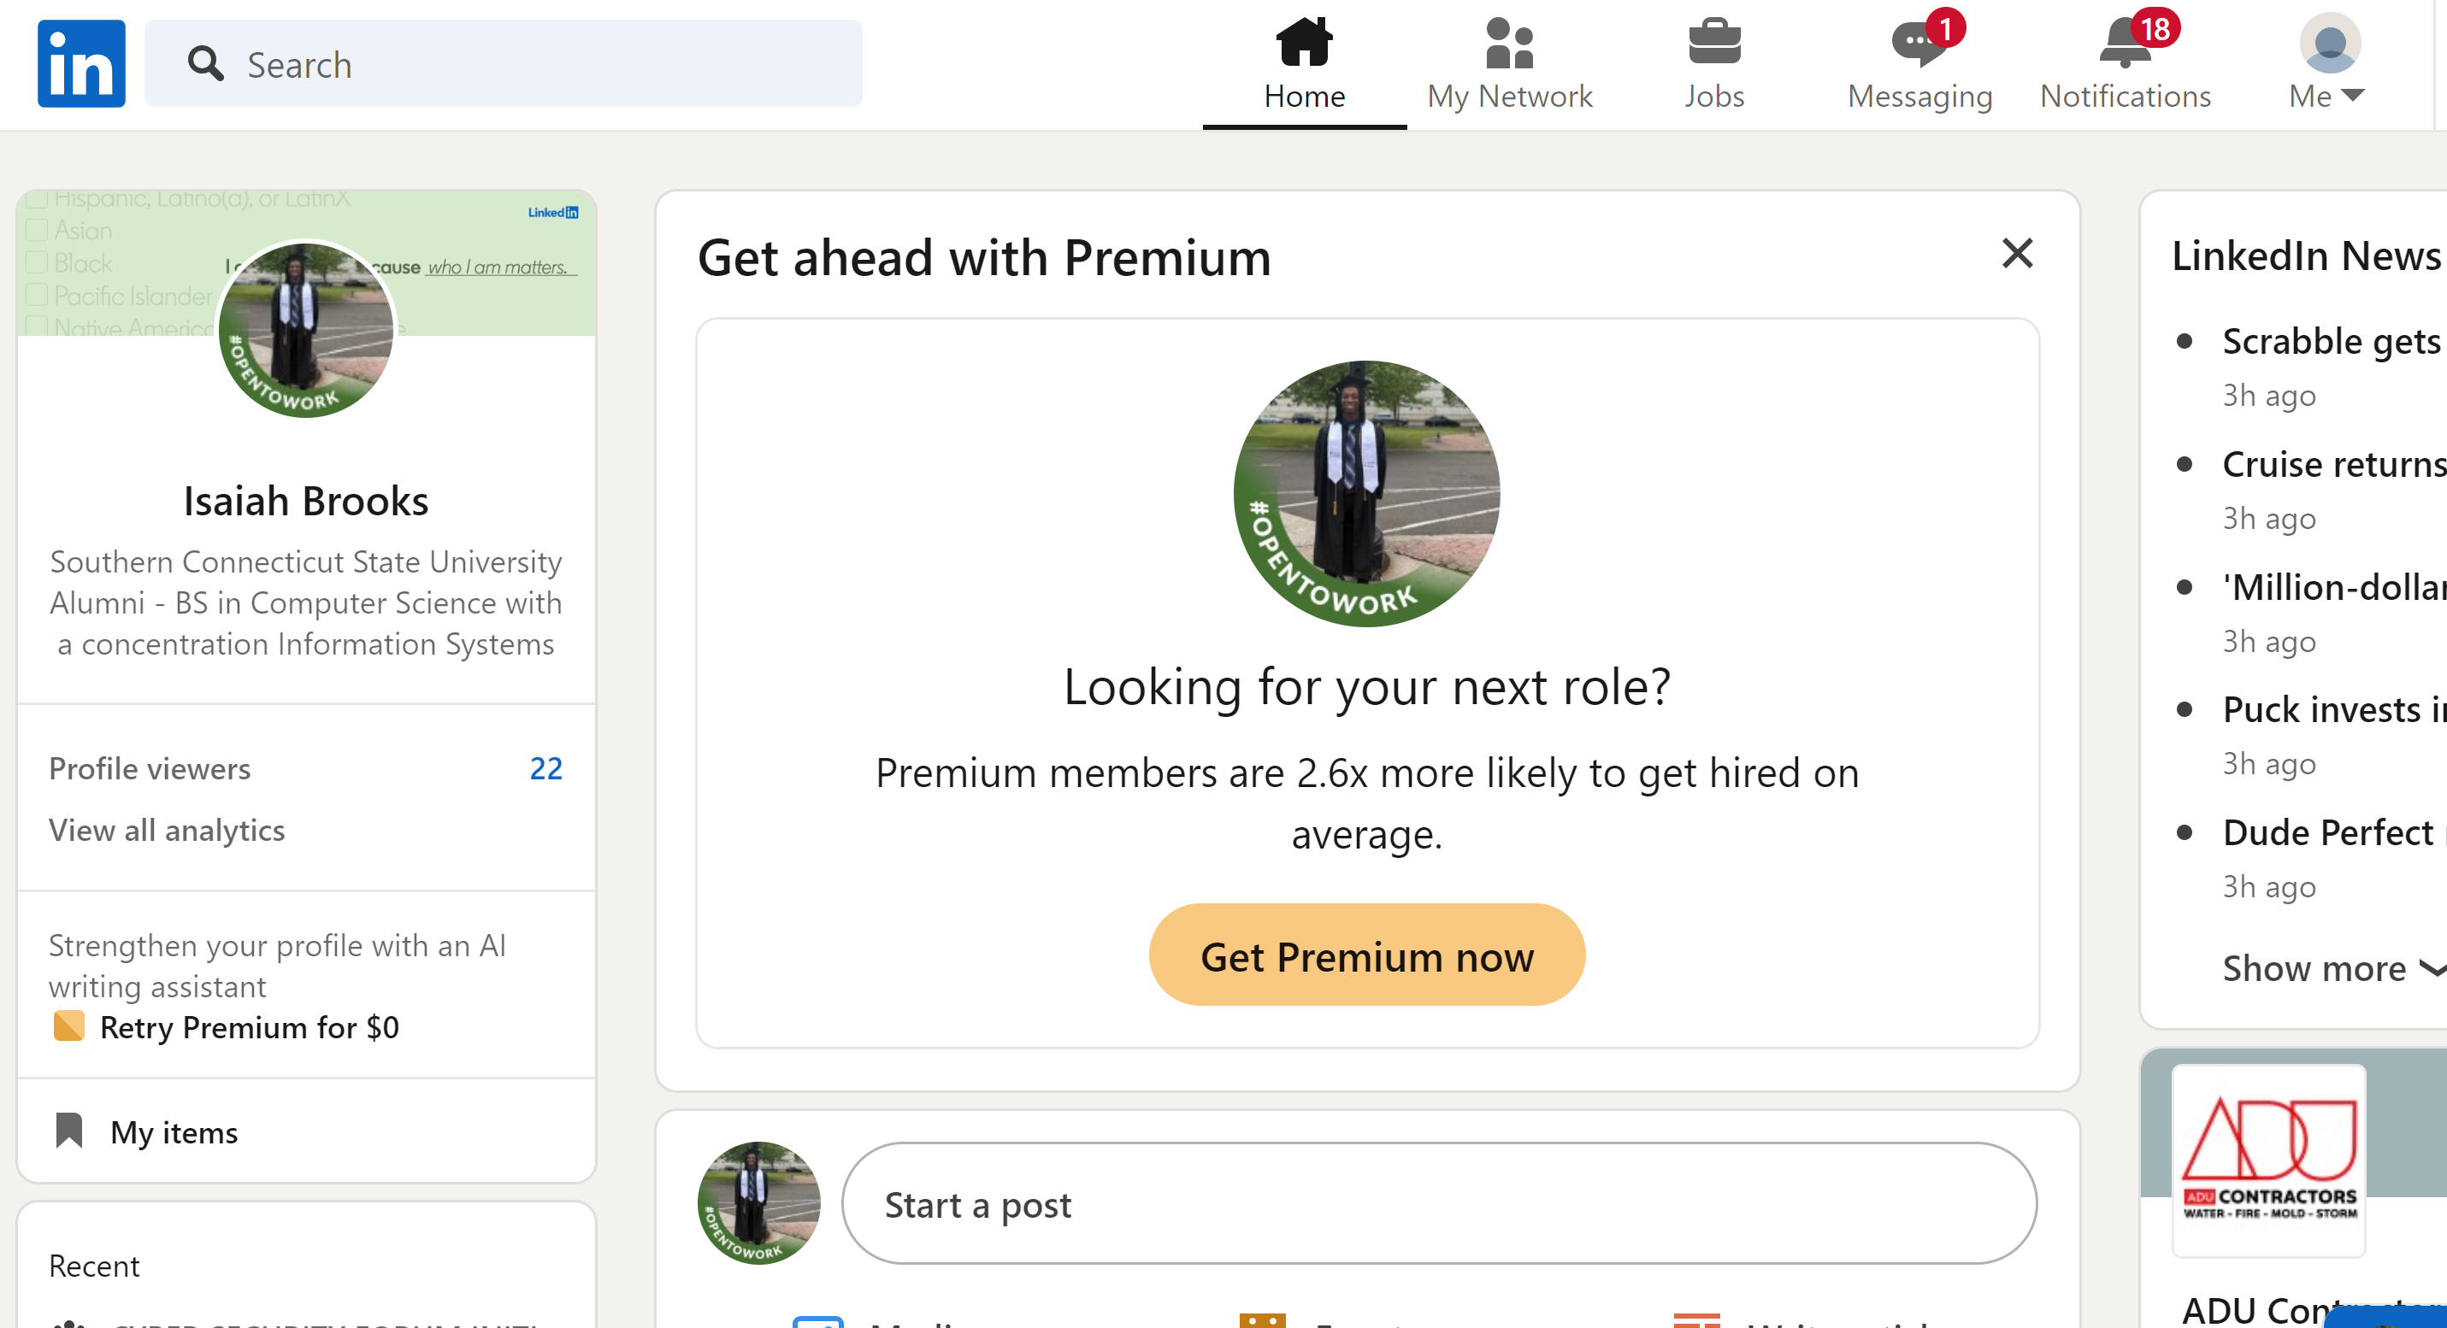
My LinkedIN

