Slide 1
Cyber Liability Presentation
Disclaimer:
The material presented in this presentation is not intended to provide legal or other expert advice as to any of the subjects mentioned, but rather is presented for general information only. You should consult knowledgeable legal counsel or other knowledgeable experts as to any legal or technical questions you may have. Further, the insurance discussed is a product summary only. For actual terms and conditions of any insurance product, please refer to the policy. Coverage may not be available in all states.

Slide 2


Biographies
Charles P. Bellingrath
Partner & National Practice Leader: Cyber/Tech
Chas Bellingrath is a Partner and National Practice Leader for Cyber, Privacy & Technology E&O at ARC Excess & Surplus, LLC. In his role Chas is responsible for advising agents and clients on issues related to technology, privacy and cyber related risks as well as negotiating with carriers on policy terms and conditions.
Chas specializes in tailoring tech, cyber, and breach response coverage and advises clients on breach preparedness and incident response planning. In addition, Chas is responsible for product development and production throughout the United States. Prior to joining ARC, Chas was a Senior Broker band head of the Cyber/Tech division at a regional wholesaler where he initially launched the product in 2007.
Chas brings ARC over 15 years of dedicated Cyber, Privacy & Technology risk expertise. Chas is globally recognized and frequently instructs privacy seminars and participates on executive panels for Cyber Risk conferences. Chas also sits on several Producer Advisory Councils for top insurance carriers and the PLUS CyberRisk Task Force.
In 2019, Chas received his CCIC (Cyber Cope Insurance Certification) from the Heinz College at Carnegie Mellon University.
2
2

Slide 3

Exposures & Trends
3
3

Slide 4
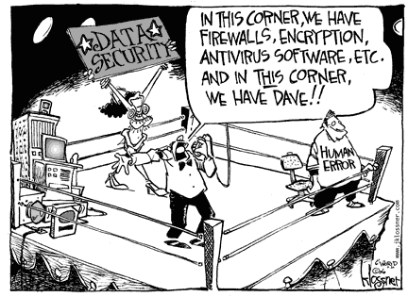
4
4

Slide 5
Intro to Ransomware Epidemic
Ransomware is a type of malicious software that blocks access to a computer system or data stored therein
• WHAT: Two types of ransomware:
– Non-encrypting: locking access to system and demanding payment of a
ransom to unlock
– Encrypting: encrypting files themselves, threating to destroy or leak documents, and demanding a ransom in exchange for a decryption key
• In 2020, FBI received 2,474 complaints with adjusted losses of over $29.1 million.
Adjusted losses more than tripled from 2019 to 2020.
https://www.ic3.gov/Media/PDF/AnnualReport/2020_IC3Report.pdf
https://www.ic3.gov/Media/PDF/AnnualReport/2019_IC3Report.pdf
We are also seeing bad actors steal sensitive or confidential information and threatening to publish the information publically if the ransom is NOT paid.
5
5

Slide 6
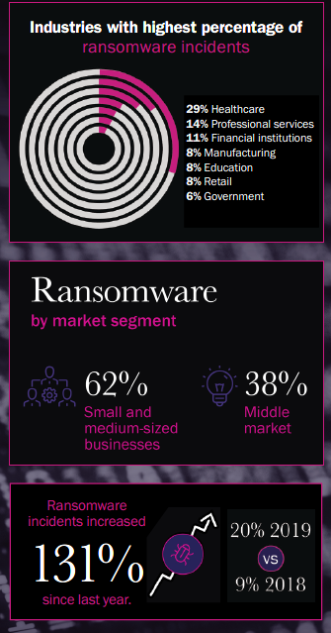
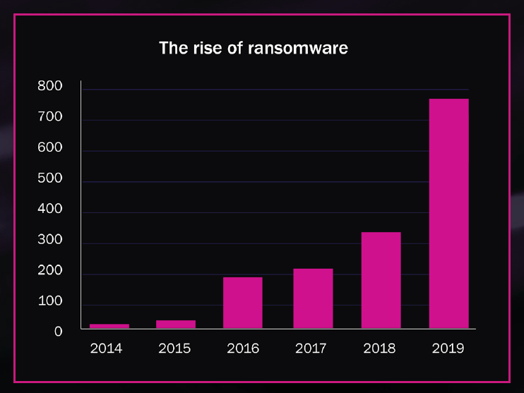
The Ransomware Epidemic
According to Beazley’s Breach Response Briefing, Ransomware incidents skyrocketed 131% in 2019 and in a most recent report from Coveware, the average payment rose to $111,605 in Q1 2020. Up 33% from Q4 2019.
6
6

Slide 7
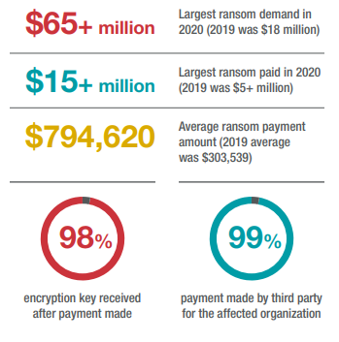
The Ransomware Epidemic
7
7

Slide 8
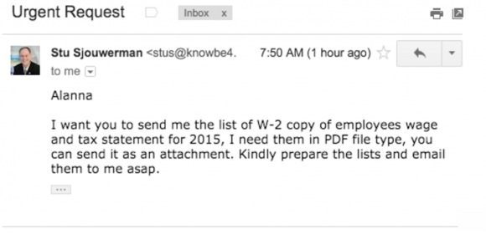
W-2, Business Email Compromise & Phishing
Scammers use emails from a target organization’s CEO, asking human resources and accounting departments for employee W-2 information.
Scammers phish online payroll management account credentials used by corporate HR professionals.
Scammers send emails pretending to have important Documents, or important new O365 mailbox audit log functionality
Reverse Social Engineering
8
8

Slide 9
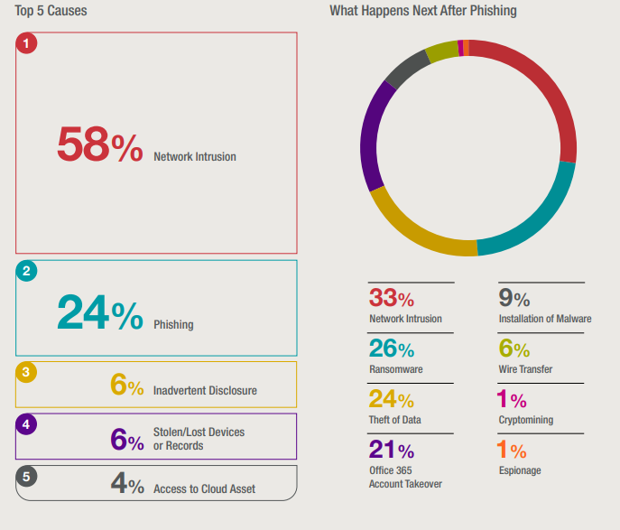
Top 5 Causes
Source: BakerHostetler Data Security Incident Response Report 2021
9
9

Slide 10
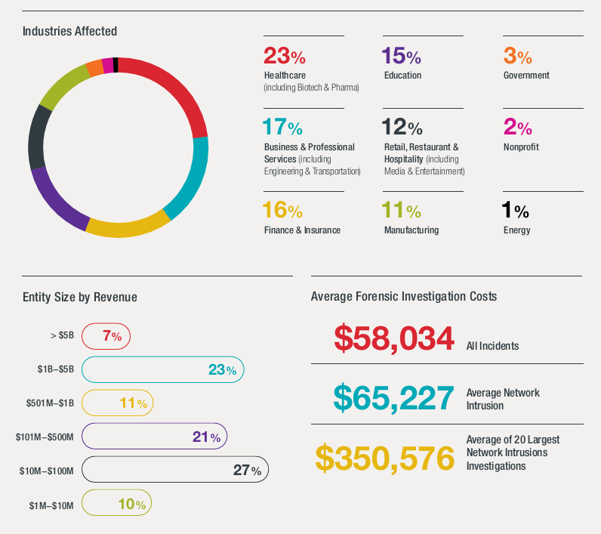
Who is being targeted and Average Forensic Costs
Source: BakerHostetler Data Security Incident Response Report 2021
10
10

Slide 11
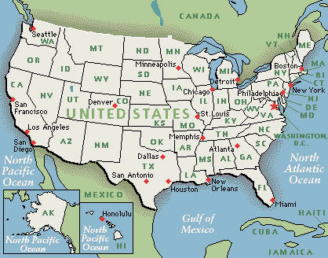
State Laws
All 50 States have Security Breach Notification Laws
Laws vary between jurisdictions
Varying levels of enforcement by state attorneys general
Limited precedent
  What does “access” mean?
  What is a reasonable notice time?
11
11

Slide 12

The Coverage
12
12

Slide 13
Coverage Sections
Breach Response
Legal Services
First-Party
Extortion
Interruption
Third-Party
Cyber, Privacy and Network Security Liability
+Regulatory
+ Payment Card
Forensics
Media Liability
Restoration
Notification
Credit Monitoring
Public Relations
Cyber Crime*
13
13

Slide 14
Important Provisions & Reminders
  Know your responsibilities as an Insured
    Reporting Security Incidents in a timely fashion
      Engaging with your broker and carrier (s)
      Reporting via email
      Breach Hotlines
  Breach Response Vendors
    Can we use our own counsel, forensics??
    Panel list review
      Scheduling Preferred Counsel
  Risk Management Portals and Additional Loss Mitigation Services
    Tabletop Exercises
    Security Awareness Training
14
14

Slide 15
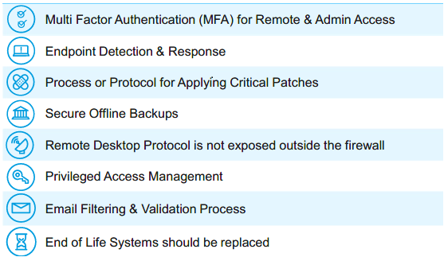
Top Cybersecurity Controls – Requirements!!
15
15

Slide 16
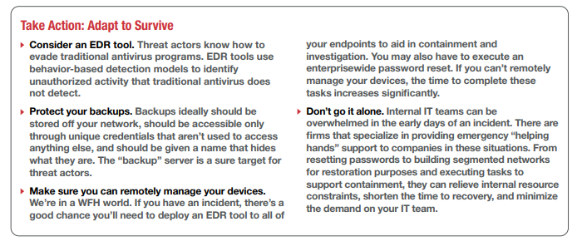
Take Action!
16
16

Slide 17
Contact Information
Charles P. Bellingrath, CCIC
Partner & National Practice Leader: Cyber/Tech
ARC Excess & Surplus of MA LLC
495 Old Connecticut Path, Suite 110
Framingham, MA 01701
Direct: 857.239.5051
Cell: 860.819.4395
Email: cbellingrath@arcne.com
www.arcbrokers.com
17
17

Slide 18
Questions?
As a specialty insurance brokerage firm, ARC Excess & Surplus provides innovative specialty solutions, offering superior client service nationwide.

